Slide 1


Hosted by:
Servers and Databases
Where all the magic happens

Slide 2


More Workshops This Year!
https://making.engr.wisc.edu

Slide 3

What is a GPU
Graphics Processing Unit
Separate hardware designed to process graphics

Slide 4
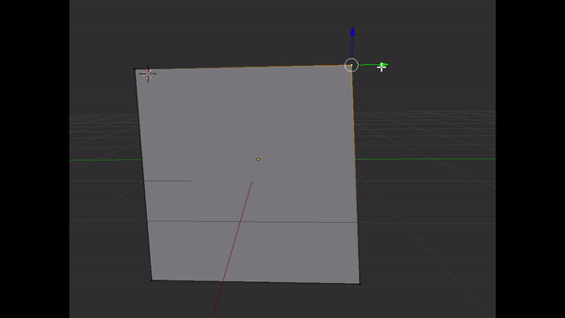
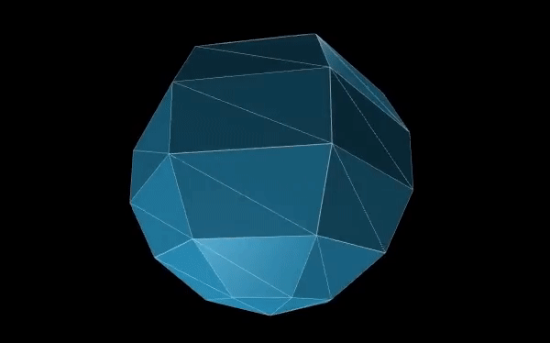
Why all this trouble for GPU
I want to move a vertex
…LOTS of vertices
1 second
16.66 ms per frame
60 frames

Slide 5
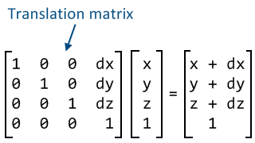

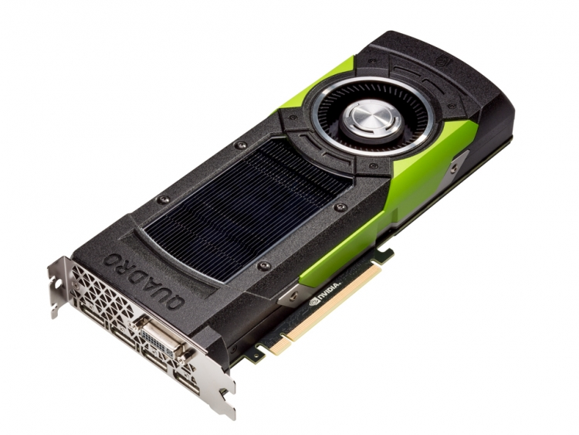
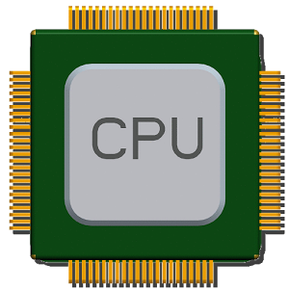
GPU designed for parallel

Slide 6
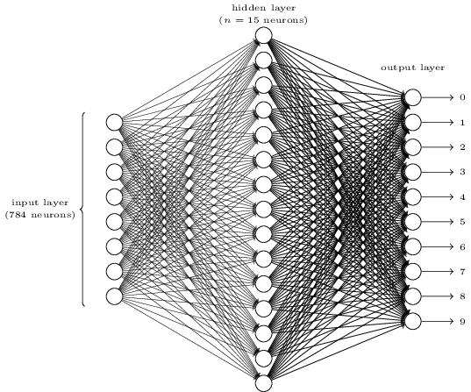






GPU outside graphics

Slide 7

Case example
Index: 0 1 2 ……………. N-1 N
A
+
B
=
C

Slide 8
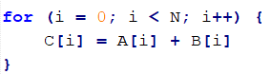
N = 10 billion
CPU @ 3Ghz – 1 thread
3.3 seconds
Not considering the rest of the computer can’t use the CPU for this time
GPU @ 1Ghz – 4096 threads
2.45 milliseconds

Slide 9
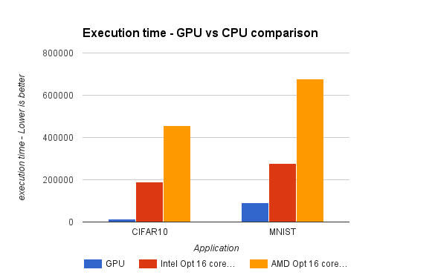
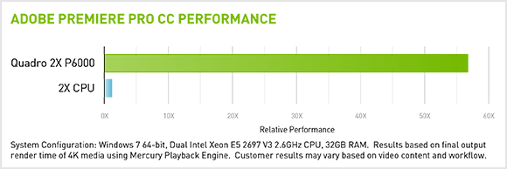

Slide 10
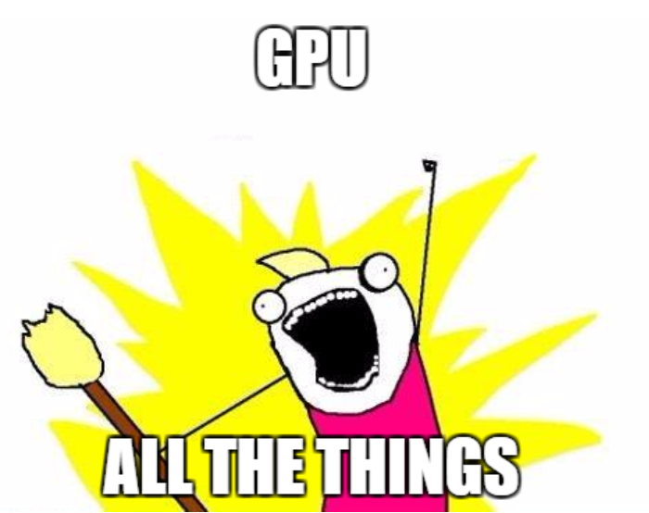

Slide 11
Case example
Index: 0 1 2 ……………. N-1 N
A
+
B
=
A

Slide 12
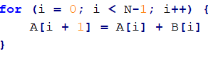

A[4] = A[3] + B[3] and A[3] = A[2] + B[2]
Run in parallel
no way to know which happens first

Slide 13
Data transfer is bottleneck
CPU takes 1 second to compute
GPU takes 0.00001 seconds to compute
Takes 1 second to transfer from CPU to GPU

Slide 14
Dual GPU
Can have some tricky bugs of own
Increase GPGPU computation
Increase total graphical computation
Not useful for live graphics, such as games
Need to share same memory
Only can process it at same time

Slide 15

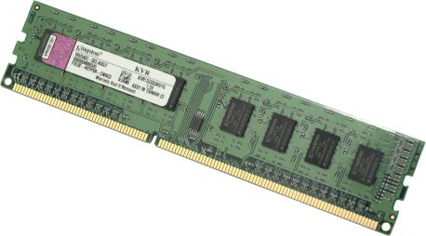
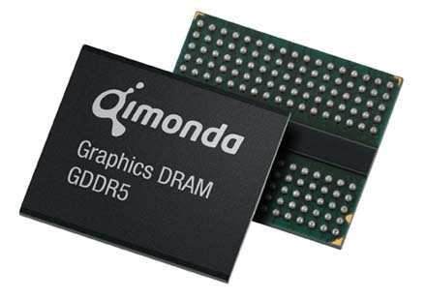
Current Computer Architecture

Slide 16
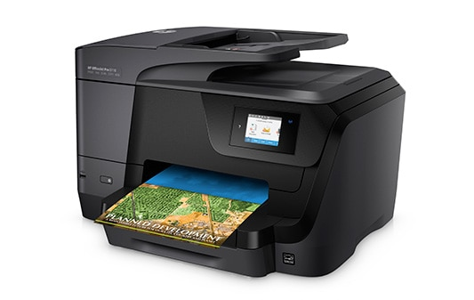



What if printers all had different ink cartridges

Slide 17

Oh wait...

Slide 18





Imagine if GPU were the same

Slide 19



Slide 20


Set of functions to talk to GPU
Almost everything supports now
All C/C++ code
ES stands for “Embedded Systems”
Lighter version, runs on Phones

Slide 21

All browsers agree on a spec
Talks to OpenGL under the hood
Lets browsers use GPU for 3D graphics
Supports around 98% of devices in world

Slide 22

How it all works

Slide 23


Slide 24



“New” OpenGL
Aim to be truly cross-platform
Apple own GPU API
Very closed community
Designed by Apple for Apple
Runs on Windows .NET Runtime
Most games currently use
Uses left-hand rule cause Windows

Slide 25
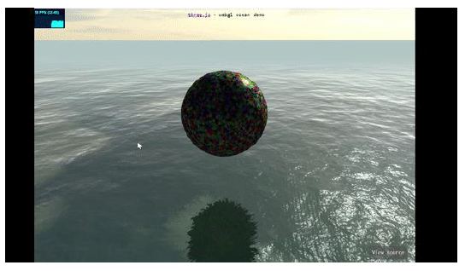
Time for some ThreeJS now!

Slide 26
Level of Abstraction
High Level
Unity or Unreal Engine
Pros: Can make cool things fast
Cons: Performance cost and programmable limits
Lower Level
Raw WebGL/OpenGL
Pros: Limit is your imagination
Cons: Limit is your time and patience
Taught in CS 559 – Will teach you a LOT about graphics

Slide 27
The middle ground
ThreeJS
Framework that wraps WebGL
High level to make developing fast and easy
Low level to still let you do anything
Works basically on every device

Slide 28
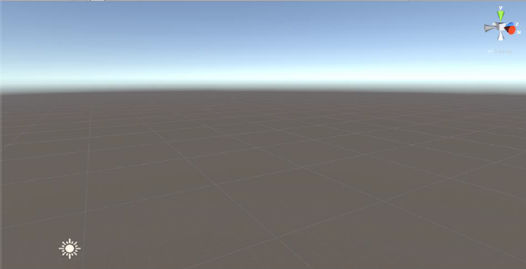

The Scene
The entire 3D realm your graphics live
Everything has a (x,y,z) coordinate

Slide 29
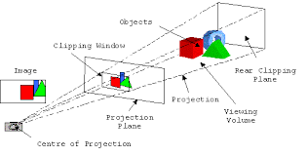
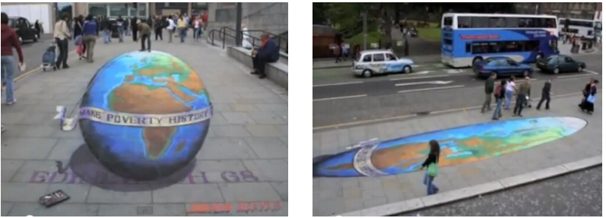
Camera – The View

Slide 30
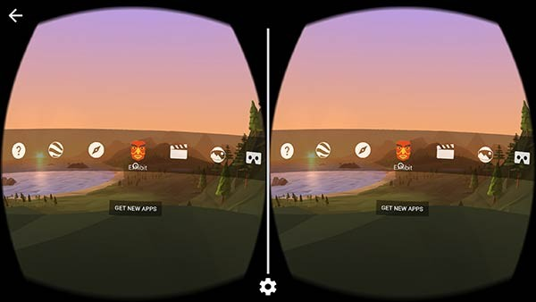
Camera – The View
VR isn’t too much different
Same camera, split into two views for headset

Slide 31
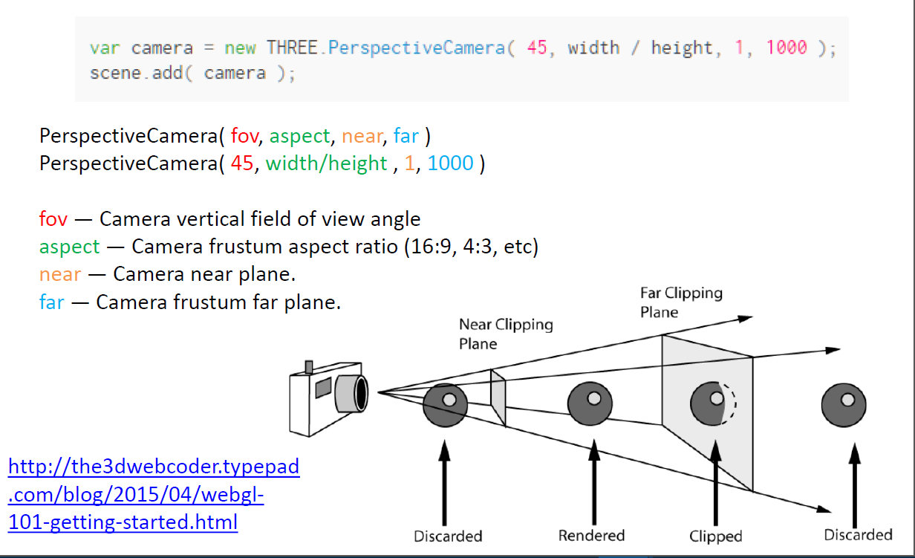
Camera in ThreeJS

Slide 32
3D Models
Nurbs
Mathematically based
SolidWorks, AutoCAD
Used for realistic modeling
Hard to model
Pologonal
Shape made up of individual Vertices
Maya, Blender, 3ds Max
Can look like anything you want
Used for Movies CGI, Games, VR, etc

Slide 33
3D models
Collections of Vertices that each have (x,y,z)
3 or more Vertices make a Face
Ex. Cube
Has 8 Vertices, 12 Edges, 6 Faces

Slide 34
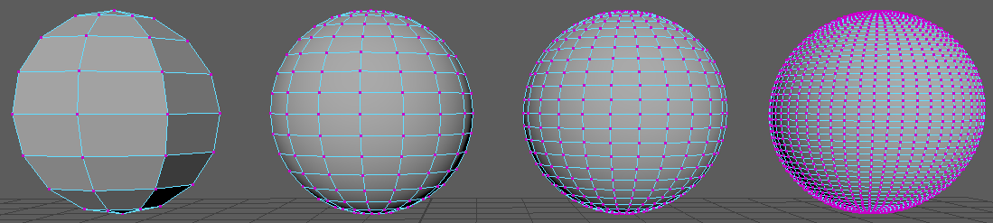
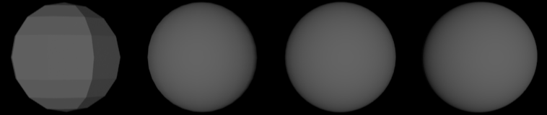
Poly Count
The more vertices, the more realistic/detailed
Also more computer has to computer.
58 Verties
64 Faces
242 Verties
256 Faces
554 Verties
576 Faces
2452 Verties
2500 Faces

Slide 35
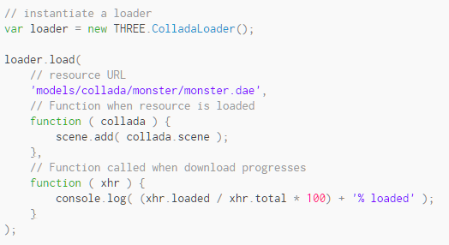
Importing Models – THREE.js
THREE.js has “loaders” for various types

Slide 36
Animation Cycle
Everytime the program computes and displays the image results
Called “Frames”
Note: 1sec / 60 = 16.6 ms
That’s not much time for a computer to compute everything it needs

Slide 37
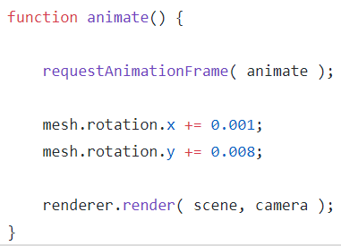
Animation Cycle – THREE.js

Slide 38
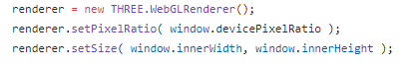
Renderer
The part that makes the WebGL calls
LOTS of “magic” under the hood
Accept it works to start off

Slide 39
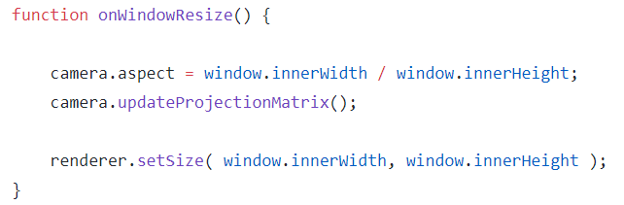
Animation Window Resize

Slide 40
Material and Textures
Material != Textures
Material can have multiple textures on them
Each object has only 1 material on it.
A more complex object can be made of many smaller objects (ex. Car has different materials for tires then doors)
Materials hold info like Color, Transparency, Reflection, etc.
Textures are generally pictures (.jpeg, .png, etc.)

Slide 41
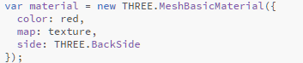

Material – THREE.js
← Many parameters possible to set

Slide 42
Lights
#1 answer to “why is my scene not loading?”
Can have multiple light sources
Different types
Can set light color, intensity, direction, etc
Light controls how materials look like
Ex. Red in bright light looks different then dim light
Could take a whole semester course in lighting both theoretical or practical

Slide 43
Light Types
Ambient
Objects have basic light to them, no direction therefore no shadows
Default in ThreeJS
Direction
Simulates a even light source all aimed in same direction
Most common type for a sun
Point / Spot
Light has a source coordniate and is pointed in a direction
Equivlent of turning a flash light on in a dark room
Area
Light has a source coordniate
Emits lights in all directions around it

Slide 44

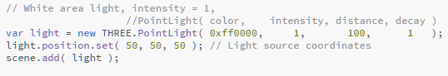
Lights – THREE.js

Slide 45
Time to get some practice!
https://github.com/ uwmadisonieee/Tutorials

